Slide 1
Canadian News
Good morning! What’s new?
Headline: Man finds black widow spider in supermarket grapes

Slide 2
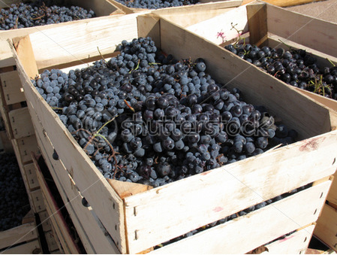

“It’s basically about…
…a man who bought several crates of grapes to make wine and found a deadly, poisonous spider.”

Slide 3
“I found this news at…
cnews.canoe.ca
??????
A Canadian online news network

Slide 4
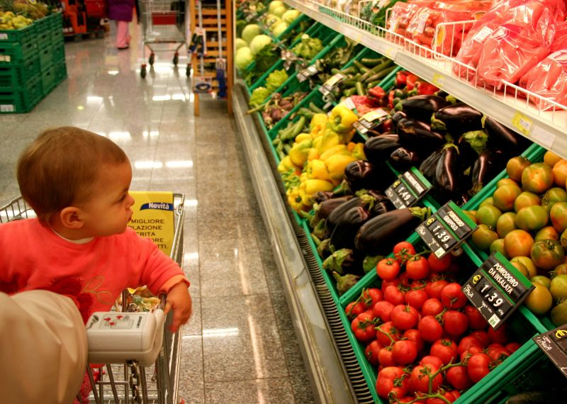
Interesting?
Relevant?
“I think this news is relevant because it’s important that our food supply is safe!

Slide 5
Useful vocabulary
made a joke
went online
bare hands
one of the most dangerous x around
lethal
rattlesnake
refrigerated truck
make her skin crawl
creepy
produce (n.)

Slide 6
“This news is about…
Donato Tersign
found BW spider
crate of grapes
15 times more poisonous than a rattlesnake, lethal
bought grapes in Toronto
early September, 2010
at first, made a joke
went online, more info
using his bare hands
one of the most dangerous spiders around
survived 15 hours
refrigerated truck
wife said, “It made her skin crawl.”

Slide 7
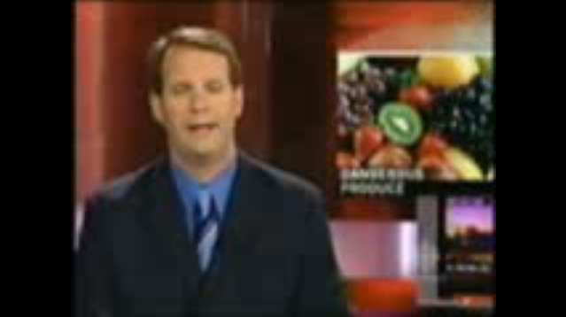
More information!

Slide 8
Questions & comments
So, what do you think? Any questions or comments?

Slide 9
Opinion: “I think…
supermarket operators
customers
work together
aware of dangers
make informed choices
know alternatives
online comments
share experiences
participate in surveys
39% had “creepy experiences” with produce
Have you?

Slide 10
“Well, I guess that’s all for now.”
Thanks for listening.

